Slide 1
Timothy, Titus, and Jude
Week Next-to-Last ☹

Slide 2
Still Christmas Shopping?
The Daily Bible Devotional ($15-20)
The Daily Bible Devotional Journal ($10-12)

Slide 3
1 Timothy Observations
Timotheos == God Honorer
Sound Doctrine == healthy teaching
Shipwrecked Faith of Alexander and Hymenaus (1613)
Handed over to Satan?
See also 1 Cor 5:5 and Matt 18:15-20
Seared consciences (1615)
Forbid marriage
Demand food abstinence
Appearance ain’t everything (1617)

Slide 4
What is the root of all kinds of evil? (1617)

Slide 5
Elders and Deacons (1614)
Elders
One woman man
Temperate
Self-controlled
Respectable
Hospitable
Able to teach
Not given to drunkenness
Not violent; gentle
Not quarrelsome
Not a lover of money
Manages family well (children respect)
Not a recent convert
Good reputation
Deacons
Worthy of respect
Sincere
Not much wine
Not pursuing dishonest gain
Hang on to deep truths w/ clear conscience
Must be tested
One woman man
Manage house well
Wives
Worthy of respect
Not malicious talkers
Temperate
Trutworthy

Slide 6
Worthy of full acceptance
“Christ Jesus came into the world to save sinners—of whom I am the worst.” 1613
“We have put our hope in the living God, who is the Savior of all men, and especially of those who believe.” 1615

Slide 7
Titus
The Gospel produces Godliness. There is no distinction between belief and behavior.
Your deeds prove or disprove your claim to know God.
Christian living always is self-sharing.
Good leadership is vital.
Deal with error quickly, because of #1.
The Gospel is the basis for everything.

Slide 8
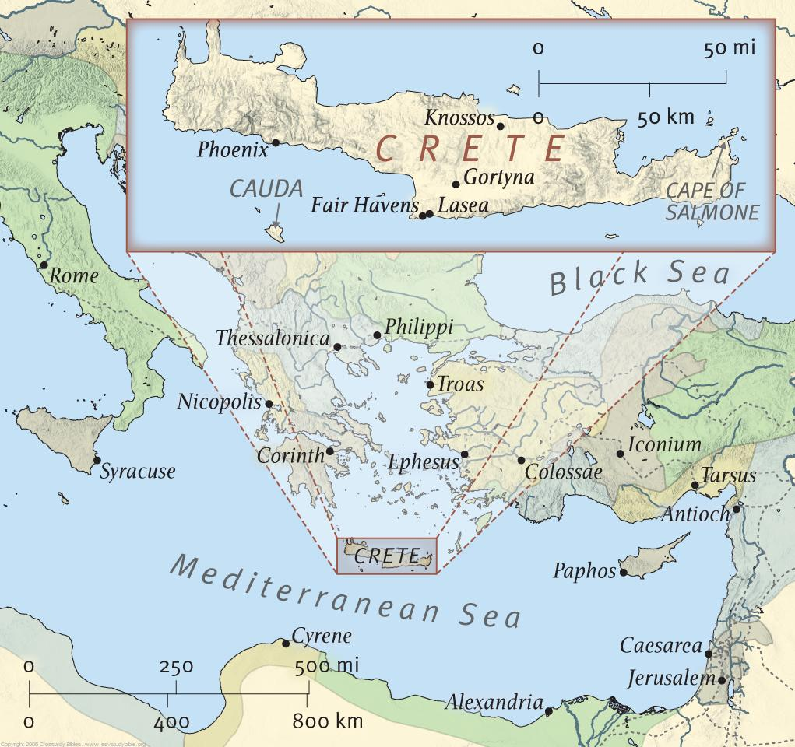
Titus worked in Crete…
Ever heard of a Cretan?
Epimenides Paradox
“Epimenides was a Cretan who made one immortal statement: ‘All Cretans are liars.’” (1:12)
How does this affect his ministry?

Slide 9
Titus Observations
Elder Qualifications
Warning of False Teachers
Teaching Specifics
Older Men: be temperate, worthy of respect, controlled, healthy in faith, love, and endurance
Older Women: reverent, no slander, no addiction, teach what is good, train the younger to love families, be self-controlled, pure, busy at home, kind, subject…
Young men: be self-controlled. Integrity, seriousness, and soundness.
Slaves: be subject, please masters, don’t steal, don’t talk back, show trustworthiness that Glorifies God!

Slide 10
Titus taught a class that asked hard questions…
(1620)
Rabbi Hillel was asked, Why have the Babylonians round heads? To which he answered, ‘This is a difficult question, but I will tell the reason: Their heads are round because they have but little wit.”
Will excrement smell in Paradise?
Does something holy come from your gut?

Slide 11
2 Timothy
Sincere faith in a single-spiritual-parent house (1620)
Be a good soldier, a good Olympian, a good Farmer (1621)
A trustworthy saying: “If we died with him, we will also live with him; if we endure, we will also reign with him. If we disown him, he will disown us; if we are faithless, he will remain faithful for he cannot disown himself.”
Don’t quarrel!
Respect for God’s Word

Slide 12
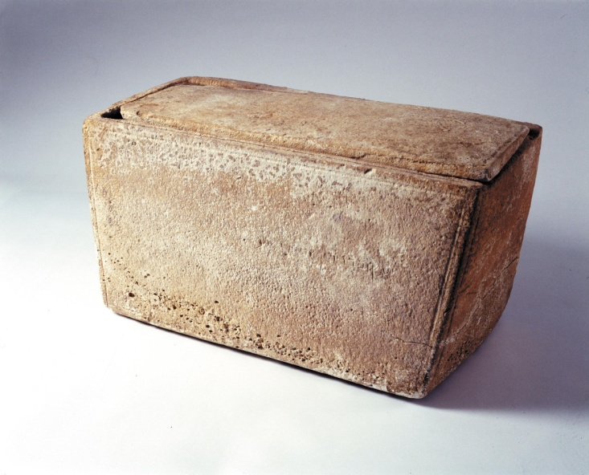
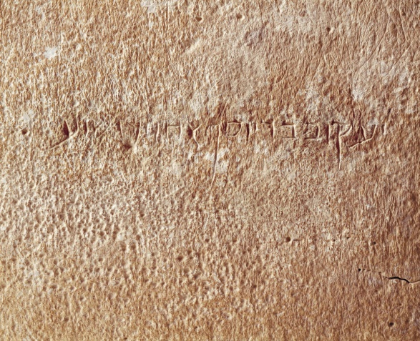
James: practical!
Probably the half-brother of Jesus
James the Just (a Nazarite)
The James Ossuary: don’t get your hopes up

Slide 13
James
What is real religion?
What is the real church supposed to do?
Why do people fight?
What does faith accomplish?

